Slide 1
Idaho Division of Vocational Rehabilitation
Career Counseling Presentation
WIOA Section 511 Subminimum Project
Notes:
<SLIDE 1>
Introductions: first few slides are general housekeeping before the heart of the presentation (but introduce yourself here first)

Slide 2
Why are we here?
A new law requires us to come out and give information to everyone across Idaho who is working for less than minimum wage.
This information is about the choices you have, and help that is available to find work in the community that pays at least minimum wage.
Part of the information is in this presentation today. Also, we will give you more to take with you that you can look at on your own or with your family or friends about how to prepare for and get a job in the community if you choose to.
Notes:
(CC element: Informed Choice) – will be reinforced throughout the presentation
Facilitators: Let them know the estimated time this will take (TBD, but will vary dependent upon group size, level of interaction, etc so note this will be a rough estimate…BUT should take no longer than X hours)
A new law requires us to come out and give information to everyone across Idaho who is working for less than minimum wage.
This information is about the choices you have, and help that is available to find work in the community that pays at least minimum wage.
Part of the information is in this presentation today. Also, we will give you more to take with you that you can look at on your own or with your family or friends about how to prepare for and get a job in the community if you choose to.

Slide 3

Group Confidentiality
As a member of this group, we ask that you respect each other’s privacy and keep what is said during the meeting confidential.
We encourage you to share your experiences during the meeting, but we ask that you not discuss what is said by others outside of the meeting.
We can’t guarantee that everything that is shared within the meeting will stay in the room, so please share only what you are comfortable talking about.
3
3
Notes:
Stress the importance of following these guidelines.
Answer any questions these guidelines might prompt.
As a member of this group, we ask that you respect each other’s privacy and keep what is said during the meeting confidential.
We encourage you to share your experiences during the meeting, but we ask that you not discuss what is said by others outside of the meeting (that is what we mean about keep it confidential).
We can’t guarantee that everything that is shared within the meeting will stay in the room, so please share only what you are comfortable talking about.
3

Slide 4
common hurdles
To seeking competitive employment
Notes:
Next we are going to talk about some common hurdles people can face when trying to look for work. These include being able to speak up for yourself, understanding how a change in work can impact your benefits, and the expectations people have of you and you have of yourself.

Slide 5

What is Self-Advocacy and Self-Determination?
Making decisions about your own life
Making your voice heard
Choosing what job you want to do and where you want to do it
It involves making choices, asking for help when needed and setting goals for your life
Notes:
Dialogue: So a part of why we are here, is to promote self-advocacy and self-determination. Can anyone tell me what self-advocacy is?
Activity: <Give some time for thought, take 5 minutes to work around the room, be encouraging with any responses, even if they seem off, work to correct without telling them they are wrong, it can be helpful to have them talk around their response to get more information (can you tell me a little more about that?)>
It is important that you get to make your own decisions about your life, self-advocacy is about making your voice heard. It is about you being able to choose what job you want to do and where you want to do it. It involves making choices, asking for help when you need it and it is about being involved in setting your own goals for your life.

Slide 6

What About my SSI?
Many people on SSI are worried about how a change in work will affect their SSI
There are supports called work incentives that make sure that people on SSI or SSDI will not lose their benefits if they go to work in the community.
The truth is that working always means that you will make more money at the end of the month than if you didn’t work.
IDVR and other agencies can help you and your family or guardian understand more about work incentives if you want.
Notes:
Dialogue:
Many people on SSI are worried about how a change in work will affect their SSI
There are supports called work incentives that make sure that people on SSI or SSDI will not lose their benefits if they go to work in the community.
The truth is that working always means that you will make more money at the end of the month than if you didn’t work.
IDVR and other agencies can help you and your family or guardian understand more about work incentives if you want.

Slide 7

High Expectations
Have you had someone in your life expect a lot from you?
Have you ever accomplished something that you didn’t think you could at the start?
  How did that make you feel?
High expectations can result in people accomplishing more
Notes:
ACTIVITY:
(Can I get everyone to Raise their hands if--) Have you had someone in your life expect a lot from you? (wait a moment)
(Raise of hands) Have you ever accomplished something that you didn’t think you could at the start? (ask one or two to volunteer a little more about what that was…then ask the following of that individual if it was a good one)
How did that make you feel?
High expectations can result in people accomplishing more

Slide 8
Understanding you
It is important
Notes:
<SLIDE 8> Understanding you (transition slide)
So we’ve talked about choice and your right to choose your own path and your own plan in life. One of those choices can lead you to VR for help in reaching higher goals. One thing VR is good at is helping you find a job that is right for you based on what you like, things you are good at, where you see yourself and what you want to do. This next section takes you through a few examples of how VR can help you reach higher expectations. These next two slides, we’re going to need your help. So get ready, I’m going to ask around the room for some helpers to answer these questions.

Slide 9

“I Am Someone Who…..”
Enjoys_________
Hopes to_______
Collects_______
Believes in________
Likes to _______
Knows how to_______
Thinks that _____is the most important thing in life!
Notes:
(Interactive Exercise: Read the statement “I am someone who” prior to each element)
--Ask for a volunteer for each element, have one person answer one and move to the next person if possible. If the group is smaller, it is ok to get more than one answer from one person. Keep an eye on time for this slide and cut out elements if needed.
9

Slide 10

What Are My Strengths?
Suppose the owner of a restaurant needs someone to wash dishes at his restaurant.
He says that he’ll hire the person who has the best strengths or skills for that job.
What would you tell the owner about your strengths? What strengths would be important for you to have on this job?
Notes:
Optional (choose a different job to discuss OR ask them about jobs they are interested in to explore one) OR just use the original:
ACTIVITY (read first two points then ask the questions):
Suppose the owner of a restaurant needs someone to wash dishes at his restaurant.
He says that he’ll hire the person who has the best strengths or skills for that job.
What would you tell the owner about your strengths? What strengths would be important for you to have on this job?
10

Slide 11

How do I Decide what Jobs are Right for me?
Look for jobs that match your interests, strengths and preferences
RESEARCH information about your jobs of interest.
TALK to someone who does that job.
VISIT the workplace of that job.
VOLUNTEER to get some experience related to that job.
11
Notes:
Dialogue:
So…how do I decide what jobs are right for me…
There are a few ways of getting a better understanding of what jobs may be right for you. On this slide are different ways of finding out more about jobs that match your interests, strengths and preferences.
Research just means looking into information about different jobs. This can be one way to get a better understanding of what different jobs are like, but some career exploration tools (like the career index plus that we will talk about later) have videos that you can also watch to learn more about a job before reaching out to learn more.
When you are ready to learn more about a given job, it can be helpful to talk to someone who works in that area. People like to talk about what they do, and by talking with someone you may become more or less interested in the job depending on what they have to say. If you find that you are more interested in the job after talking with someone, you may want to consider…
Visiting the workplace (This gives you the ability to see hands on what the job is … but this is just a snapshot in time and you won’t be able to get a feel for everything) for that to occur…
Volunteering may be an option. Volunteering doesn’t pay you but does let you spend extra time on the worksite so you can learn more about what goes on there from day to day. By volunteering you also help make yourself known to the people who work there and might have a better chance at being offered a position.
11

Slide 12
Finding the right job
For you.
Notes:
<SLIDE 12> Transition Slide
Finding the right job for you
So once you get an understanding of what you like to do, it is helpful to look at what different jobs require from applicants.

Slide 13
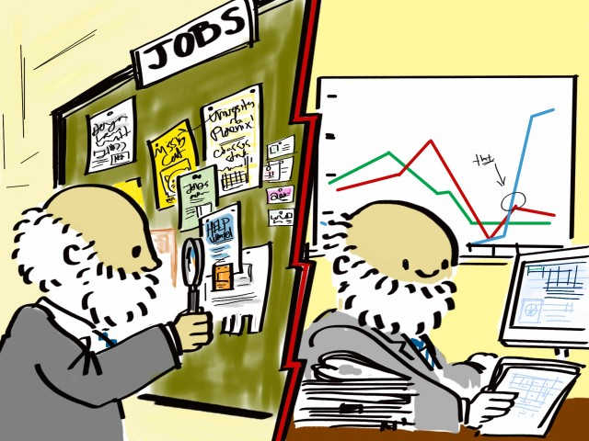
Labor Market Information: Helping you Understand Different Jobs
Another way you can make informed choices about where you want to work is to look at labor market information or LMI. Below are a couple of different sources of LMI.
Idaho Career Information System
The Career Index - Plus (beta)
Notes:
Another way you can make informed choices about where you want to work is to look at labor market information or LMI. Below are a couple of different resources to explore LMI.
LMI can tell you about what jobs are available in your area.
It is important that job seekers and members of the workforce have access to labor market information in order to make informed choices. Staff that provides guidance to job seekers often get labor market information to talk about with you.
LMI can answer questions like:
What jobs are available that fit well with my skills, interests and experience?
What are the requirements to get a job? What is the job like?
What are the wages, benefits, hours, and potential for promotions for particular jobs?
Which jobs are employers having the most difficult time finding people for?
Where can I obtain needed education, training and services?

Slide 14

Career Exploration Activity
Name:
My dream job would be:
My next job might be:
My Strengths:
Notes:
In thinking about work, we have a lot to consider. A few of those things are the type of work, pay, hours that you want to work, and any benefits that might come with a job (in other words, some of the information that comes from LMI). So, keeping these in mind think about what your dream job is…dream big.
<Pause for processing, pick back up when it looks like people are ready>
…OK, now that you have your dream job in mind, what kinds of jobs do you think that people with that job did first to get a start in their career? Or put another way…to help get closer to your dream job, what might your next job be? Think about your dream job and your strengths when thinking about what this might be? Note: (this might be hard for them, consider an example to be given from the presenter) (Nursing Assistant → Nurse) – (Teacher’s Aide → Teacher)

Slide 15
Bridging the gap
Notes:
<SLIDE 15 Transition Slide – Bridging the gap>
Just like with the last activity -- Sometimes you might have some but not all of the skills an employer is looking for and that is ok. One thing VR does is help figure out what you need to bridge the gap between what you know and what you need to know to get a job.

Slide 16
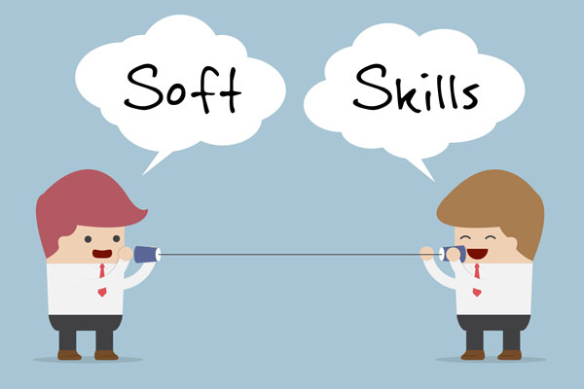
The Importance of Soft Skills
What are soft skills?
They include:
The ability to get along with others on the job (teamwork)
The ability to accept feedback from your supervisor
Showing up for work every day and on time and looking good
How you handle stress
Notes:
Soft skills are important to employers.
What are Soft Skills?
Soft skills refer to skills that help make someone a good employee and to get along with co-workers and supervisors. They can be an important part of making employment a success. They include the ability to get along with others on the job, the ability to accept feedback from your supervisor, showing up for work every day, showing up on time and looking good, and how you handle stress.
Many times people might lose a job, not because they can’t do the job, but because they need better soft skills to better get along with everyone on the job. VR can help with soft skills training if you need it.

Slide 17

VR can help on the job
For people who need it, VR can help with a job coach to help you on a new job.
Another way VR can help are through accommodations on the job, which is any change in the way things are usually done to help a person do the job.
Notes:
VR can help on the job
For people who need it, VR can help with a job coach to help you on a new job.
Another way VR can help are through accommodations on the job, which is any change in the way things are usually done to help a person do the job

Slide 18
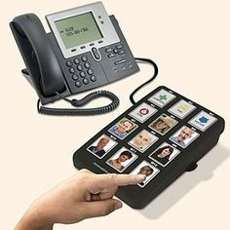

Types of Job Accommodations
Modifying a work schedule
Providing a reader or interpreter
Using large print for written materials
Assistive technology:
Notes:
Some examples of job accommodations include
Modifying a work schedule
Providing a reader or interpreter
Using large print for written materials
And Assistive technology:
You can see a couple examples of assistive technology on the slide.

Slide 19

People You Know:
Your Support Network
People, such as…..
Family/neighbors
Guardian
Friends
Teachers/guidance counselor
VR Counselor
People in your community, clubs, church, etc.
They can help you find and keep a job
Notes:
The biggest help there is in finding a new job is the people you know also known as your support network. They can help let you know about jobs that are out there, can help you research different jobs, and may be able to put you in contact with an employer who would be willing to talk more to you about what different jobs are like.
Your support network can be anyone you know, but often includes people like family, neighbors, friends, Teachers, guidance counselor, or even a VR counselor. They can come from many settings like the community, clubs, church, school.
19

Slide 20
What Now?
Notes:
<Slide 20> Transition slide –
OK, we are almost done, only a couple more slides to get through. So what happens now?

Slide 21
Where do you go from here?
If you like where you are, you don’t have to do anything more…However:
  If you want help finding a different job, you can apply for IDVR services
  IDVR will write a plan with you to help ensure that you have what you need to be successful on the job
  We will help you with training and job search basics and provide you with support on the job
  Your packet includes information on other agencies that can help you find competitive employment in the community as well
Notes:
If you like where you are, you don’t have to do anything more, we’ll come back and deliver this training again when you need to have it…However:
If you want help finding a different job, you can apply for IDVR services
IDVR will write a plan with you to help ensure that you have what you need to be successful on the job
We will help you with training and job search basics and provide you with support on the job
Your packet includes information on other agencies that can help you find competitive employment in the community as well

Slide 22

Congratulations
Finish Completing Verification Forms at this time. Congratulations. You have completed the Career Counseling session!
Please make sure all participants have an Information and Referral Packet
Notes:
Ask if there are any questions and congratulate everyone for making it through their session. Let them know there is one more activity (completing their forms). Follow the process guidelines to print forms at the CRP (all have agreed to allow access to their printers on the day of) and issue one to the employee and one to the CRP (provided the guardian releases are either verified or ‘N/A’. In cases where the guardian signature is not present and ‘N/A’ is not checked, issue two copies back to the employee (who can then release the second form to the CRP if they wish).
Refer back to the process guidelines on documenting and uploading attendance verification information into the IDVR system.

Slide 23
Thanks!
Thanks for participating in today’s session.
This content, and the content found in the Information and Referral packets has been developed, in part, with materials provided by the Maine Division of Vocational Rehabilitation and California Department of Rehabilitation. IDVR would like to thank these agencies for their effort and willingness to share their work.
We would also like to thank the WINTAC for their invaluable assistance in developing these materials.

